Slide 1
Embedded System
Input Power Circuit

Slide 2
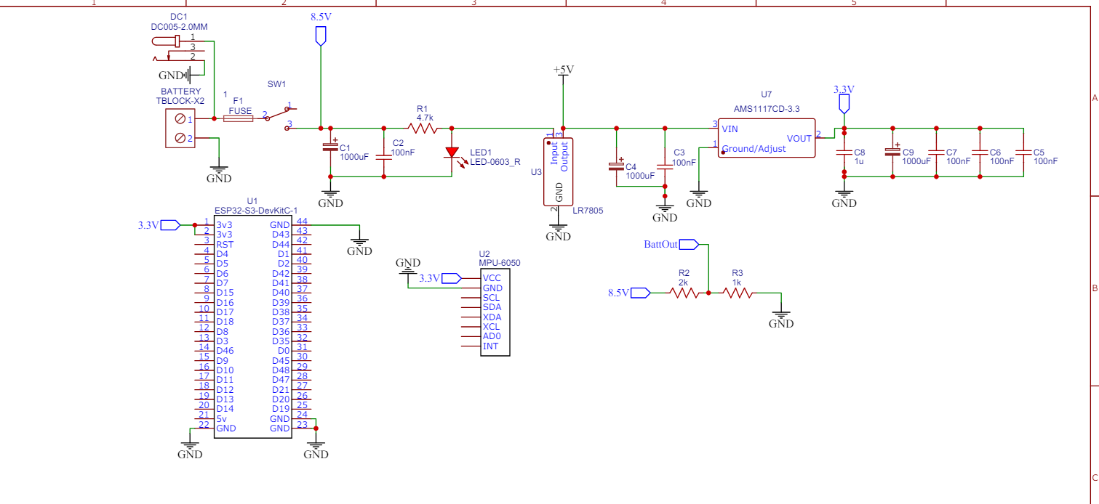

Slide 3
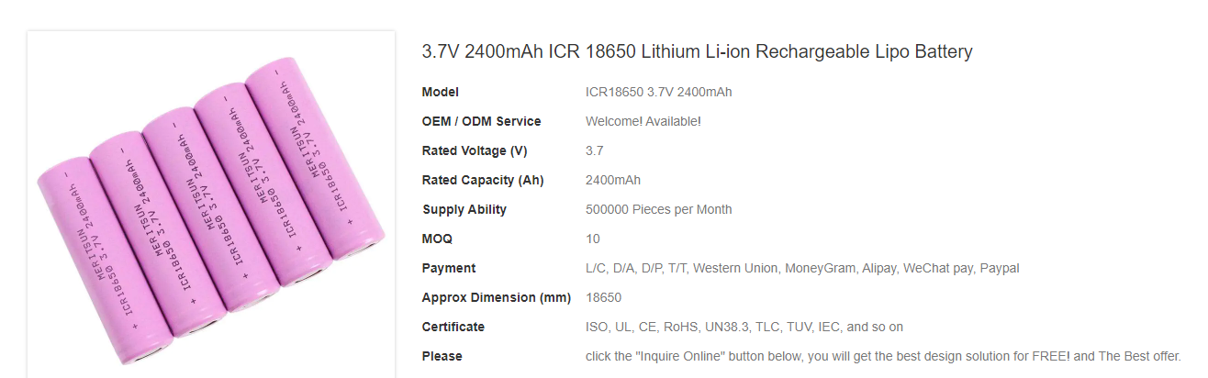
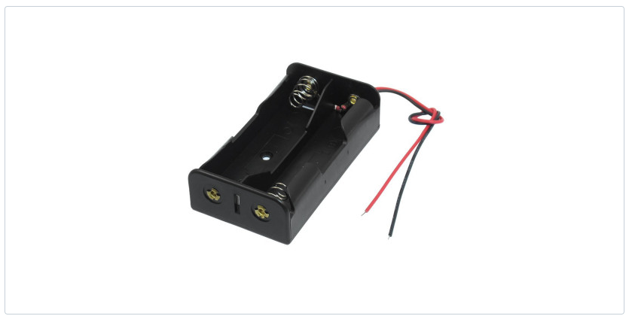
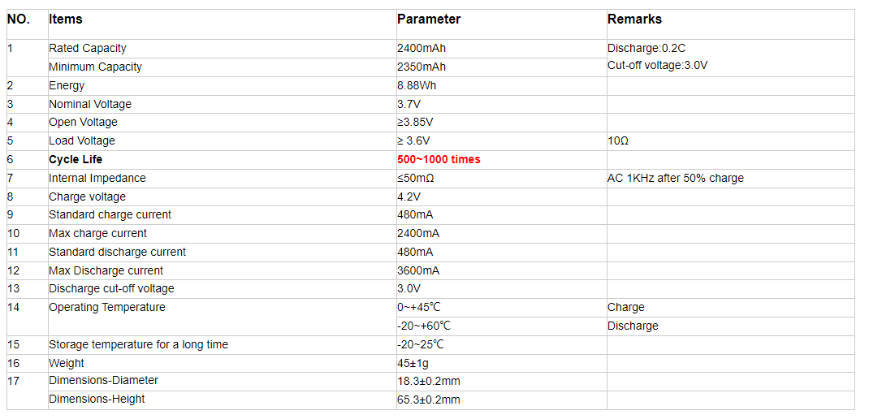
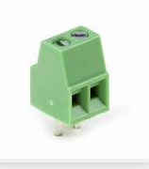
We use 2 batteryfrom that in series ( almost 8.5 V, each is 4.2 V in case of full charge ) and use also a battery holder as shown in the picture below , and we can attach that battery holder to the box with double face tape on the box which include the PCB
https://www.meritsunpower.com/3.7v-2400mah-icr-18650-lithium-li-ion-rechargeable-lipo-battery
And connect the batteries to the PCB by terminal block with 2 terminals like the following picture

Slide 4

After adding the terminal block ( 2 terminals) that is will connect to the battery holders by 2 wires, we add a fuse to protect our circuit from and Short circuit may occur in the battery or in the charging circuit that will be shown later ( fuse should be around 125% of the rating of the continuous current rating of BMS, so the fuse should be around in case of using 5A BMS, so the Fuse rating is 6 to 7A
We need also to order Through hole fuse holder and be sure it has the same physical size as the fuse itself
After the fuse add a toggle switch to turn ON and OFF our circuit and as shown we will have 8.5 V after the switch
Then we add 2 Capacitor the first Capacitor is a chemical capacitor has polarity and with a big value ( which has +ve sign to maintain the voltage in case on voltage drop ) and the second is a ceramic capacitor with smaller value to work as filter for high frequencies and ripples
The we add a resistor in series and Led ( to light up to be sure that all the previous parts are working well and we have power till that point to check the switch also is Open and Close the circuit
From the lecture part , to choose the regulator , we choose linear voltage regulator ,the input is higher voltage and have at the output the needed voltage and the difference is release as heat
Note ( We can use heat sink with the Linear voltage regulator for each one of them and the Arctic Silver Thermal Adhesive to attach the heat sink to the regulator)

Slide 5

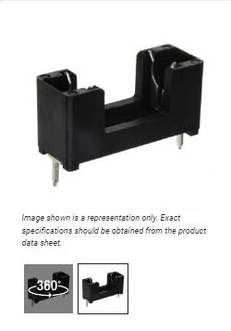
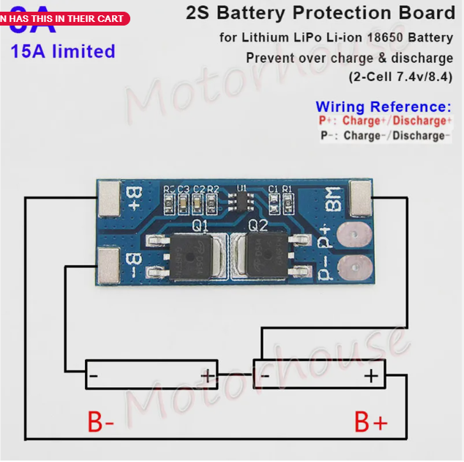
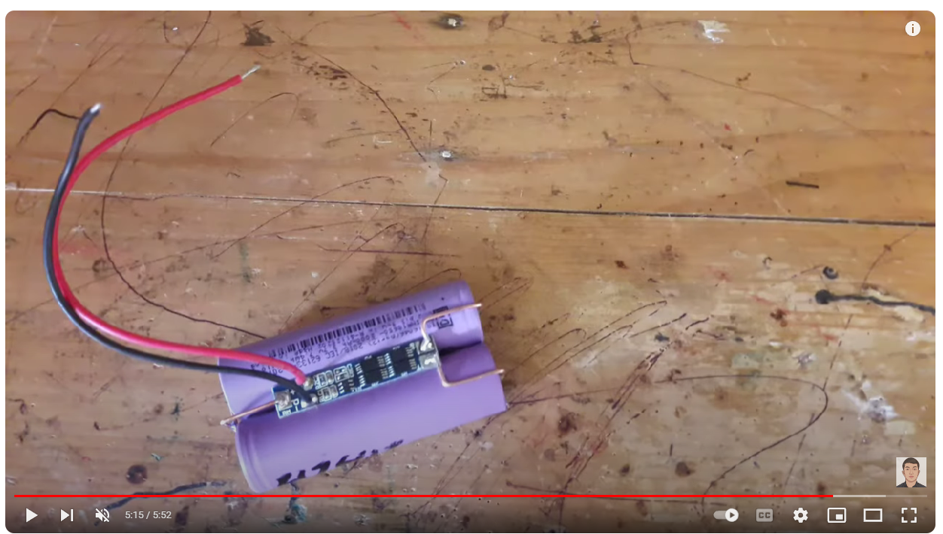
We make a stop down in 2 steps , as we knew we need 3.3V for ESP32 but usually may of devices need 5V
So we make the step down in two steps , so don’t have a very big voltage difference between input and output , so not very big heat emitted and also take the benefit of the 5V , if needed for any devices chosen later
And the previous steps we use for every voltage level chemical capacitor to maintain voltage in case of voltage drop( with big value) and ceramic capacitor (With small value) to remove high freq. as Noise ( work as low pass filter)
On the left-hand side, we have a circuit we used that Battery Management System (BMS) designed for Lithium LiPo Li-ion 18650 batteries. The purpose of this BMS is to protect the batteries from overcharge and over-discharge. And for example, if one of the battery is already charged and the other is empty , so it manage charging and also discharge ( By balancing)
And can be connected and fixed externally and directly to the battery as the following picture
https://www.youtube.com/watch?v=kx8_1GNNqMo

Slide 6
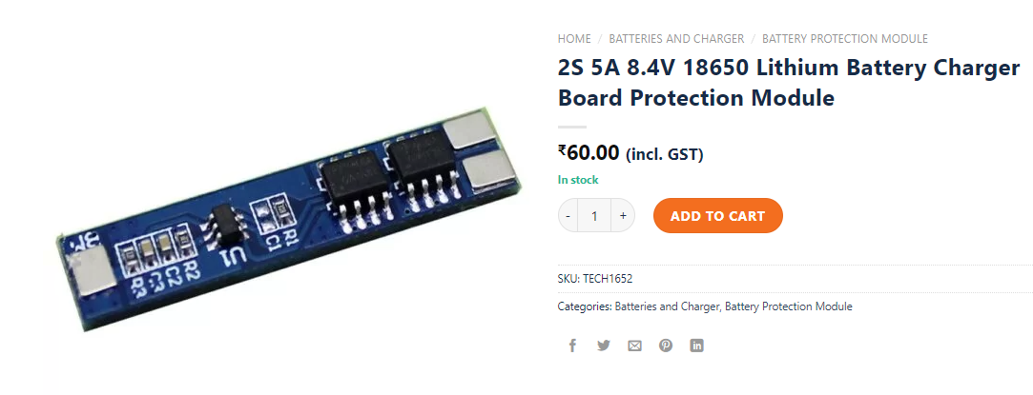
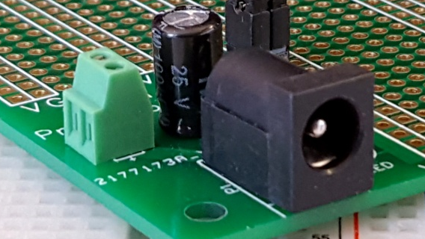
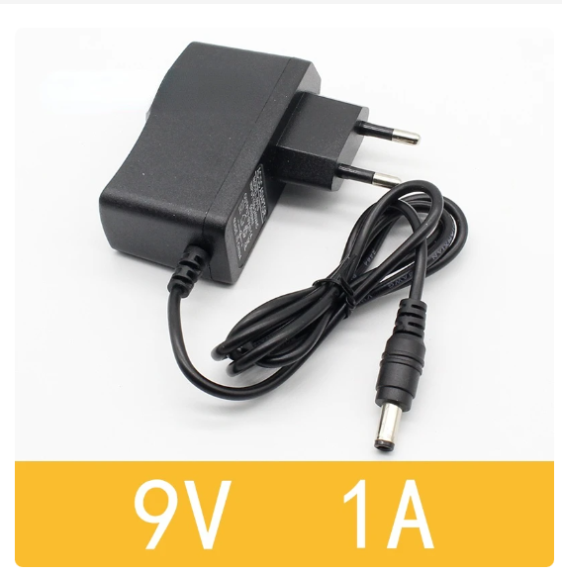
The size of the BMS ( Which means the rating current) can be calculated by making the summation of all current need to all devices in our circuit
For example, we can use 2A until 5A BMS
https://techtonics.in/product/2s-5a-8-4v-18650-lithium-battery-charger-board-protection-module/
The last step in that part is the Charging circuit , so we used that 9V Adapter to charge our batteries as the following example, and between 1.5A to 2A will be enough for the output current for charging from the Battery data sheet.

Slide 7
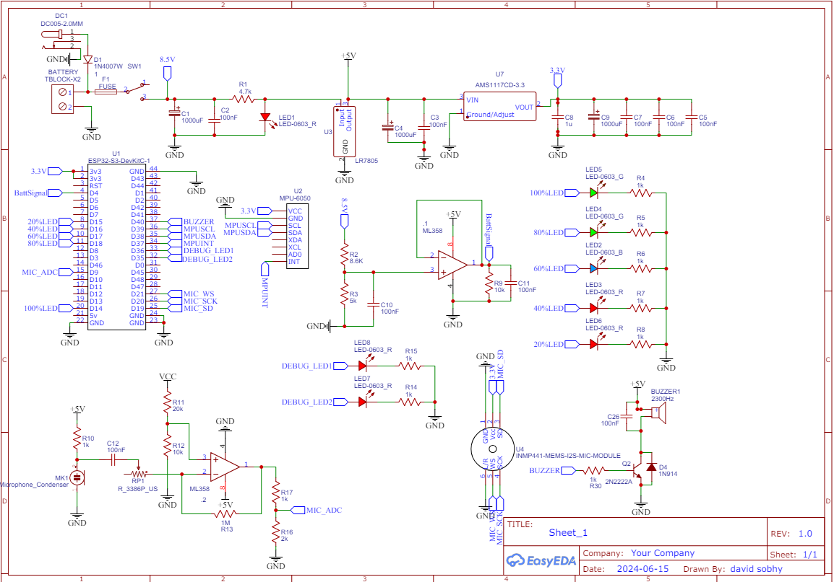
The Second part we will add
Battery level indicator circuit
Buzzer Circuit ( As speaker)
Microphone Circuit
Clapping microphone circuit
Connecting MPU6050

Slide 8
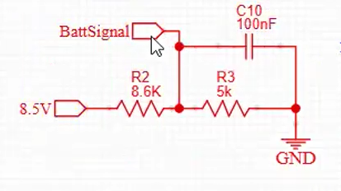
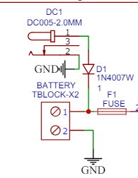
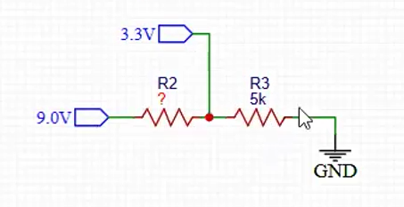
Battery Level Indicator
First, we add diode at the +ve terminal of the charger to protect the charger from any feedback from the battery and also the maximum output of the charger is around 9.25 V and the diode make a voltage drop around 0.7V , so we have voltage little bit lower than 9V to charge the batteries and also to be input for out battery level indicator circuit.
If we assume the maximum input voltage is 9V , so we need to design the resistor divider value so the maximum voltage to be input to ESP don’t exceed 3.3V
We will set one of the resistance value and calculate the other resistance value If we set the first resistive to be 5Kohm. And calculate the second resistance that make the voltage input to the ESP don’t exceed 3.3 V, so we calculate the current I = 3.3/5K and the calculate the total Resistance
By knowing the Voltage and the current and subtract the 5K resistance to know the first resistance
That prevent the voltage go to ESP to exceed 3.3V

Slide 9
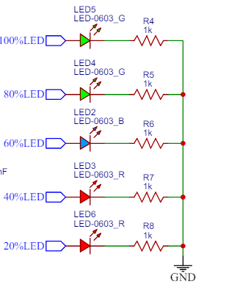
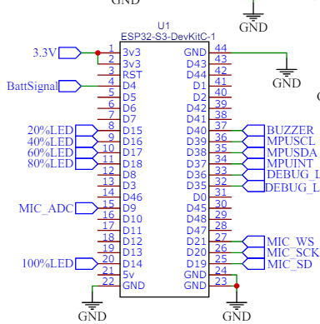
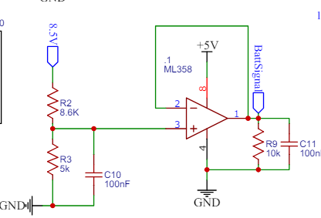
After that we make the circuit for the battery level indicator using 3 Leds each lead represent 20% of the battery level and add in series to each Led resistor to protect the LEDS and the input for that circuit come from the ESP as we will define in the software part. When the batteries is full charge all LEDs light in and according to the input value from Batt-signal we light On number of Leds shows the status of the battery charge.
The last part in out battery level indicator is using Op.Amp as voltage follower to work as a filter for the signal input to the ESP and also to use Op.Amp as Marko’s request.
The Op.Amp type used ( L358 / 2 channel / Through hole to be easy in soldering)
I will use 1 channel here and the second channel will use it later.
As usual add capacitor at the input as a filter and at the output we use high resistance (Pull down resistance ) with a capacitor to reduce noise , increase stability and as low bass filter before input to ESP
After doing the Battery level indicator , we can connect the MPU to our ESP32
As we did before but we have another opinion that no need to use INP pin from out MPU,
Because our design is simple no many tasks will be loaded on our ESP , so we need to save time consumed by ESP32 to check the position of MPU many times , and we can connect it if we want .

Slide 10
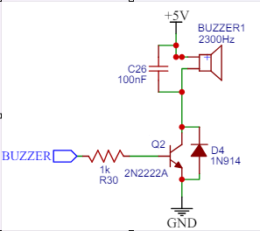
Sound generation
We have 2 options to use a normal speaker and use DAC and also may be amplifier
So we can use Just a Buzzer which generate different sounds depending on the frequency
Let’s explain out Buzzer circuit
The Buzzer is including inside just a coil , so if we connect direct 5V continuous to it we will get a BeeeeB sound
If we connect low input voltage for example 2.5 V , we will get same sound but with lower volume
Question : How to change the sound generated from that Buzzer ?
We can change it’s sound by changing the frequency ( Turn it On and Off with specific rate so we will have different sound for each frequency and for each PWM (Pulse Width Modulation ))
We can fix PWM (Ton = 50%) but we can get different tones by different frequencies
We design a driver , because we can’t connect the Buzzer directly to the controller , so we use transistor Q2 (2N2222A) to work as switch
Use diode parallel to the transistor to be as flyback protection to the transistor from the Buzzer coil.
We use a capacitor to filter the output signal to the buzzer from noise
We use the resistance to limits base current to protect the transistor.
We control the frequency to have a specific tone by ESP32

Slide 11
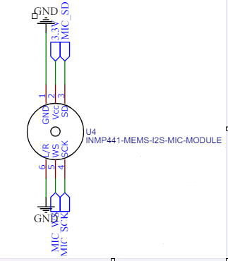
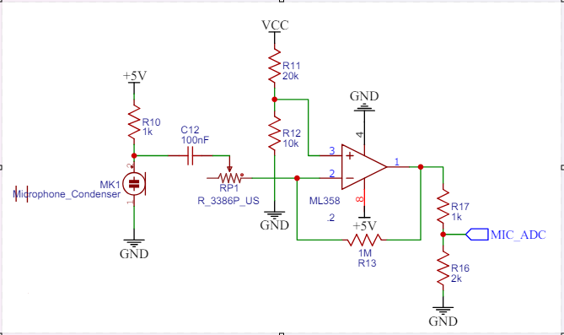
Sound Input /Microphone
We can use the Mic. That we Choose before (INMP441 ) and connect it to the ESP32
We can Choose Like Clap recognize microphone
We use Microphone condenser (Some of types have Polarity and other have no Polarity)
The maximum output of the condenser is 1V (The peak voltage from the Mic. When clap is 200mV, so we need to amplify that output)
We can use the second channel of the Op.Amp we used the first channel as source follower in battery level indicator
We use the second amplifier (LM358) channel to amplify the clapping sound
We use a capacitor in series to block DC signal (Noise ) and AC signal pass through the capacitor
We used Potentiometer RP1 to change the Gain value (Amplifying Value ) inversely proportional with the gain.
We use the 2 resistance R11 and R12 to shift our wave level to be at the +ve side (Like adding DC value to AC value , so we don’t have a –ve signal )
The maximum output of the amplifier is 5V according to the supply voltage connected to it.
We make a voltage divider at the output of the amplifier by R17 and R16 to be sure the input to ESP32 not exceed 3.3V

Slide 12
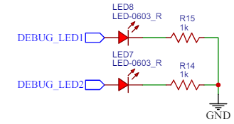
We will adjust the sensitivity of the Mic. By changing the gain ( Sensitivity and the gain are directly proportional )
We will define the clap sound with peak (Clap ) delay (Clap ) and for each pattern
We can use two LEDs as output from ESP to be sure by lighting up that the ESP receives the Clapping sound (We can use only one LED or 2 as we need or want )
More information about that microphone is explained in the following link
https://www.youtube.com/watch?v=7Ao6KD8f9J4&t=47s

Slide 13
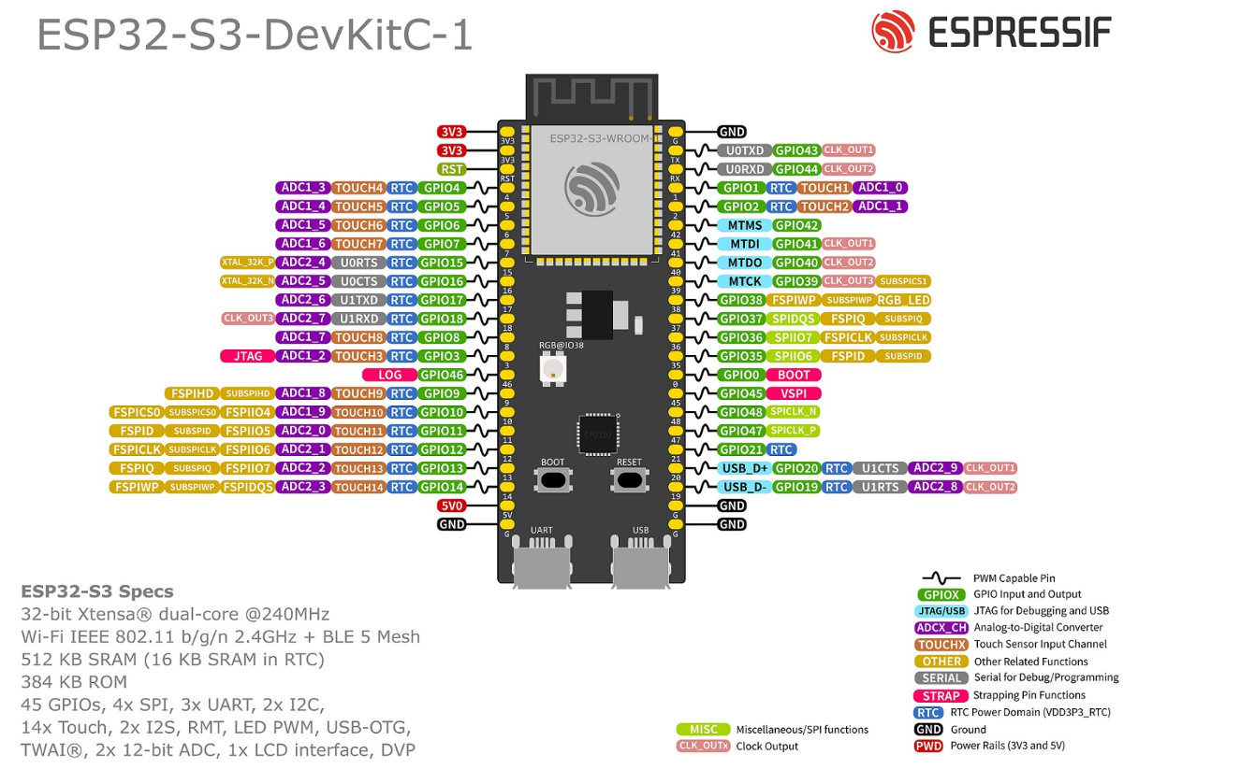
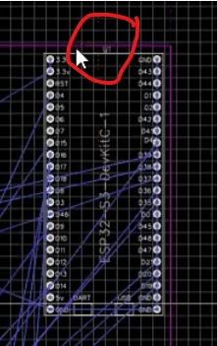
Important Notes
It is very important to check all ESP32 many times and it’s functions before connecting other devices to it (https://randomnerdtutorials.com/esp32-pinout-reference-gpios/) (Especially when using WIFI)
All resistors and Capacitors and everything should be Through Hole (TH) component to be easy during soldering , It should not be Surface-Mount Device (SMD).
The 3.3V voltage regulator (AMS1117CD-3.3) is (SMD) , we can search for similar one (TH), or we can use is , it has a little big suitable size in comparison to the resistance will not be very difficult during soldering.
Recheck all the component Pins (Especially Op.Amp we use the same Chip with 2 channel in 2 places , it is only one chip not 2 )
All the resistance are 0.25 W will be enough
As mentioned in the lecture
The minimum Track clearance = 0.2 mm
The minimum signal track size = 0.25 mm
I recommend to have minimum Power track size = 0.6 mm
Make Ground Polygon to make noise subression
Put AC tracks away from DC as much as we can
Locate ESP32 antenna at the edge of our PCB to be away from the noise generated by our circuit as shown in the adjacent figure
We can add some extra test Pins to measure the voltage for example and some Pins to be used for the un-used ESP pins , if we need to use

Slide 14
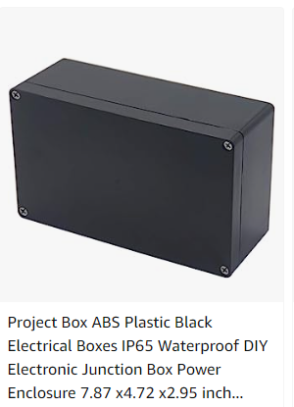
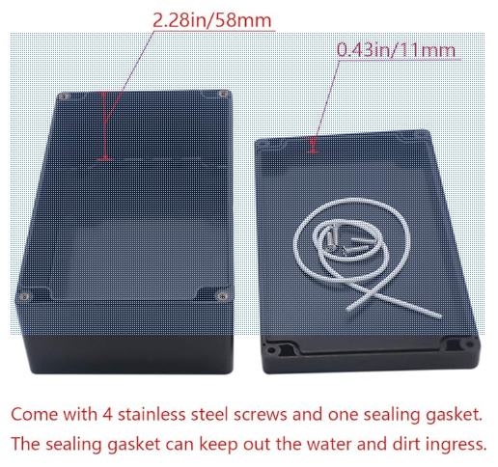
The last Note
Make some holes for fixing (0.5 mm ) to fix the PCB to the housing , we can put fixing points in the corners and if possible 1 hole in the middle

